Slide 1
Welcome to Marketing Management
Dr. Cecilia Ruvalcaba
BUSI 107 Week 4, Day 2

Slide 2
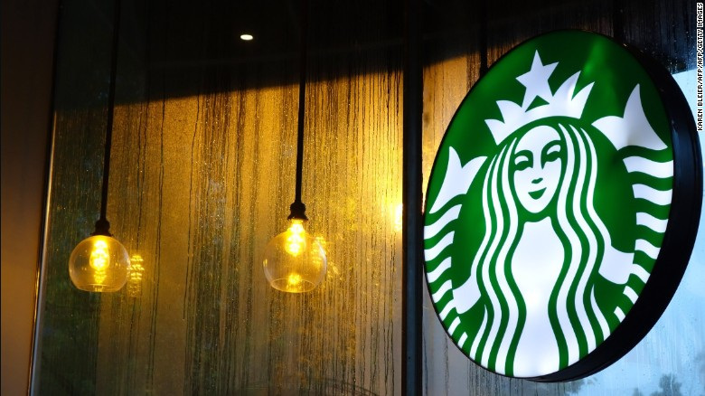

Starbucks: Localization Receives Global Response
Notes:
http://www.lefigaro.fr/conso/2016/02/08/05007-20160208ARTFIG00265-starbucks-menace-de-boycott-apres-l-affaire-du-cafe-interdit-aux-femmes-a-riyad.php
http://edition.cnn.com/2016/02/07/world/saudi-starbucks-women-
ban-feat/
http://www.telegraph.co.uk/women/life/saudi-arabian-women-banned-from-starbucks-coffee-shop-after-gend/

Slide 3
Chapter 6: Consumer behavior

Slide 4
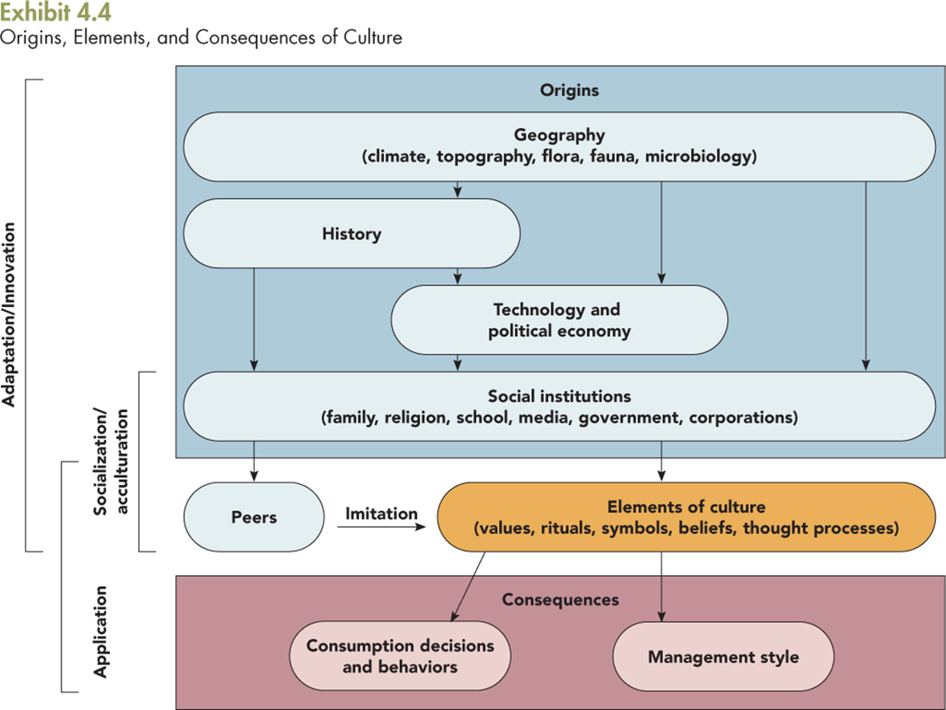

Slide 5


Enculturation, Acculturation, Assimilation
First Culture
Enculturation
Acculturation
Assimilation
Second Culture
First Culture
Second Culture

Slide 6




What Guides Behavior?
Reference Groups: Groups people refer to when evaluating their own qualities, circumstances, attitudes, values and behaviors. (frame of reference)
Social Learning Theory
"Learning would be exceedingly laborious, not to mention hazardous, if people had to rely solely on the effects of their own actions to inform them what to do. Fortunately, most human behavior is learned observationally through modeling: from observing others one forms an idea of how new behaviors are performed, and on later occasions this coded information serves as a guide for action.“ (Similar/Aspirational)
Albert Bandura, Social Learning Theory, 1977
Reference Group Membership group

Slide 7
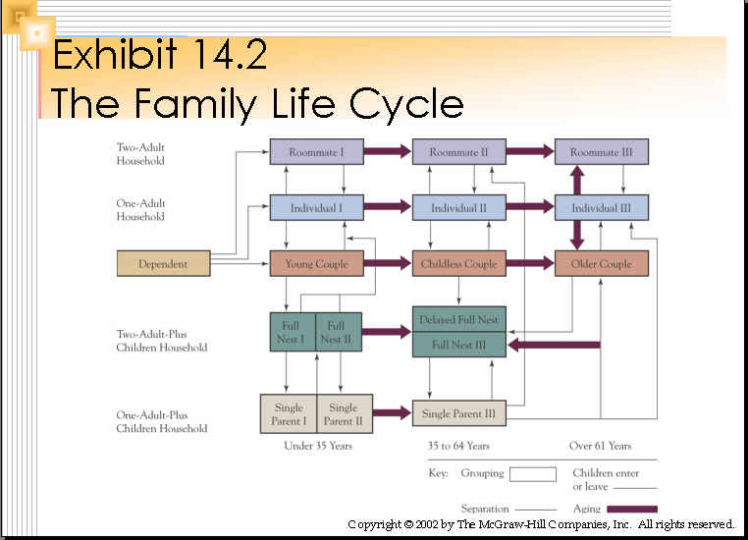
Other social influences
SOCIAL CLASS
-Indicates which medium to use for advertising
-Helps determine the best distribution for products
Occupation
Income
Education
Wealth
Other Variables

Slide 8
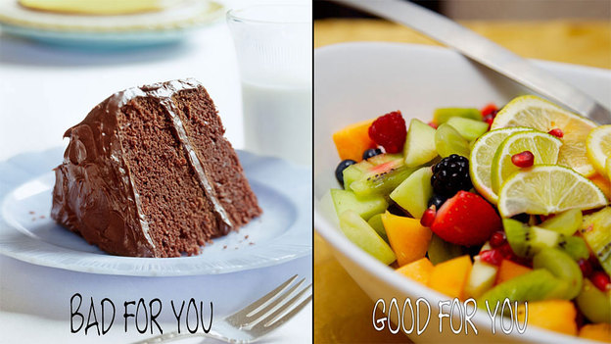
Situational & Psychological influences
Situational Influences:
Physical Features
Social Features
Time
Task Features
Current Conditions
Psychological Influences:
Product Knowledge
Product Involvement
Higher Involvement = Extensive Decision Making
Med Involvement = Limited Decision Making
Low Involvement = Routine Decision Making
Impulse

Slide 9


Take Away for Today
Consumer Behavior:
Culture is key to understanding your customer
Find your Influence:
Opportunities lie in understanding the key variables

Slide 10

Next Class
Chapter 6: Consumer Behavior cont…
Friday 2/12/16:
Submit Topic & Group Name
Wednesday February 22.
Library Database Session w/ Jack Schroeder
Exam 1: Monday February 20th

